Slide 1
Dijkstra ‘Algorithm’ {
Dijkstra.py
Made_with_pycharm.mainpy
[Single Source Shortest Path]
< By Abdelrahman Nader >
}

Slide 2
01 {
[Introduction]
Dijkstra.py
Made_with_pycharm.mainpy
}

Slide 3
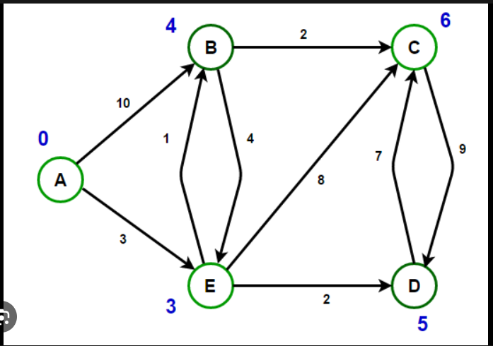
Problem Definition; {
Dijkstra.py
Made_with_pycharm.mainpy
}

Slide 4
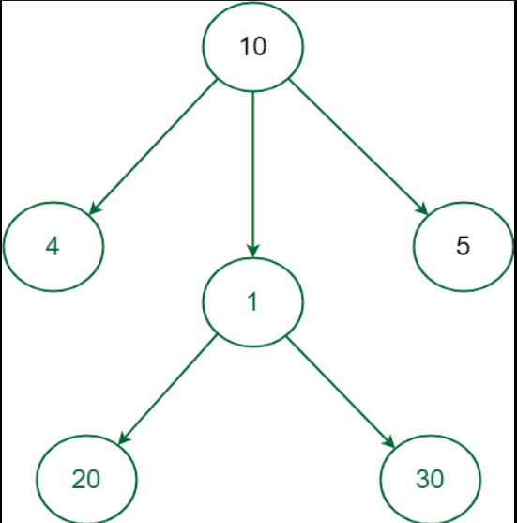
Strategy; {
Dijkstra.py
Made_with_pycharm.mainpy
<p The approach we are going to use is the Greedy approach >
</p>
}

Slide 5
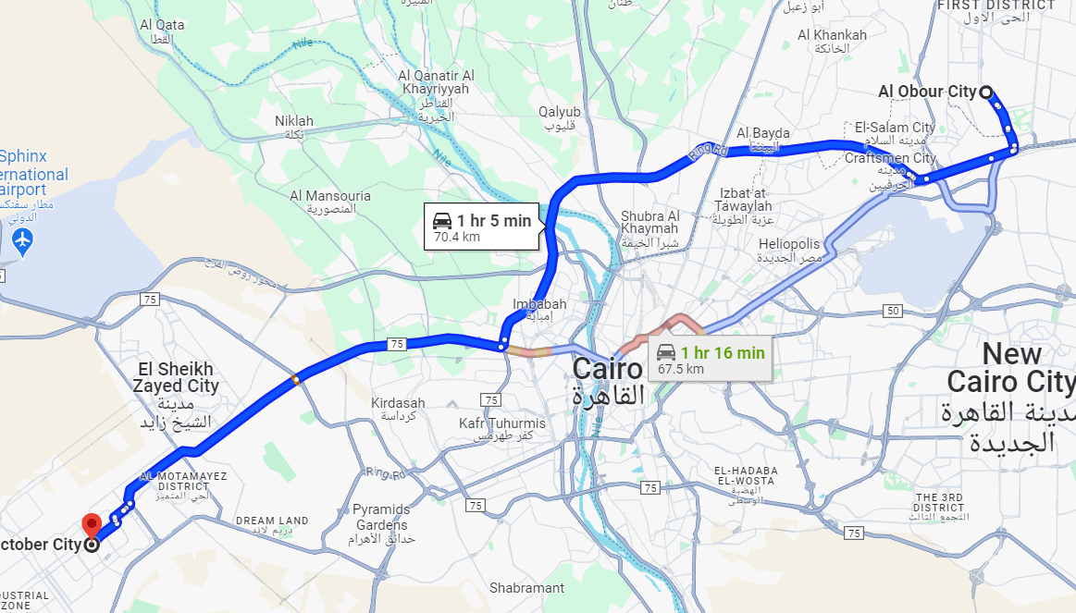
Applications; {
Dijkstra.py
Made_with_pycharm.mainpy
<p Many real life problems can be tackled with this algorithm such as finding the shortest route between two points. Whether it’s the distance between two points on a Map (google maps) or finding the shortest route to each node in IP routing the algorithm has proven to work astoundingly >
</p>
}

Slide 6
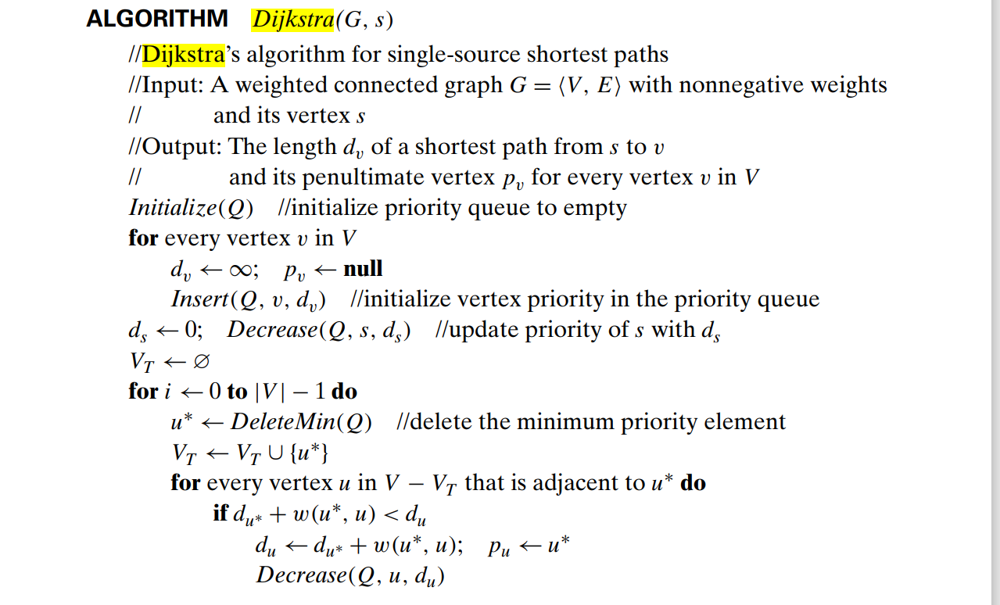
Pseudocode

Slide 7
02 {
[Implementation]
Dijkstra.py
Made_with_pycharm.mainpy
}

Slide 8
Implementation;
Dijkstra.py
Made_with_pycharm.mainpy
Step 01
Step 02
Step 03
Step 04
def Dijkstra(self, src): pq = PriorityQueue() prev = [[]] * self.N pq.put((0, src)) dist = [float("inf")] * self.N # Make the value of all priorities infinite (lowest possible priority) dist[src] = 0 # Make the priority of the start node 0 (highest possible priority) path = [[]] * self.N for i in range(self.N): d, u = pq.get() # Pop the node with the least value (highest priority) for v, weight in self.adj[u]: # Check all adjacent nodes for the current node in the adjacency matrix if dist[v] > dist[u] + weight: # Ignore paths bigger than current path dist[v] = dist[u] + weight # Update path with smaller value prev[v] = u pq.put((dist[v], v)) # add node to queue

Slide 9
Implementation ‘(cont.)’ {
Dijkstra.py
Made_with_pycharm.mainpy
Step 01
First, as mentioned before we always need the least cost available to do that we can utilize the priority queue which as the value lessens the priority rises.
Step 02
We will loop V times since each Node will be visited one time only
Step 03
We pop the node with highest priority
Step 04
Iterate over the neighbors and check if the current cost of the neighbor is more than the cost to the current node plus the cost of movement. If yes then change the neighbor cost to the current plus the cost and push the neighbor to the queue.
}

Slide 10
Data-Structures Used; {
Dijkstra.py
Made_with_pycharm.mainpy
<p There are different ways to realize this algorithm although all share the same general structure. In my implementation I will be representing the graph with an undirected adjacency list, additionally I will be using a priority queue(python’s priority queue utilizes the min-heap) to queue the nodes yet to be explored. Lastly I will use a list to save the values of least cost for each node with each value except the start initialized as infinity >
</p>
}

Slide 11
03 {
[Visualization]
Dijkstra.py
Made_with_pycharm.mainpy
}

Slide 12
Settings
Made_with_pycharm.mainpy
Light Mode; {

Slide 13
Settings
Made_with_pycharm.mainpy
Light Mode; {

Slide 14
Dijkstra.py
Made_with_pycharm.mainpy
Visualization; {
1
4
2
3
2
5
6
[Visualization]
0
7
3
4
4
}
Queue: (0,cost:0)
min-cost: 0/ inf / inf / inf / inf

Slide 15
Dijkstra.py
Made_with_pycharm.mainpy
Visualization; {
1
2
3
0
7
3
4
}
Queue: (1,cost:3),(3,cost:7)
min-cost: 0/ 3 / inf / 7 / inf

Slide 16
Visualization; {
Dijkstra.py
Made_with_pycharm.mainpy
1
2
3
0
7
3
4
}
Queue: (1,cost:3),(3,cost:7)
min-cost: 0/ 3 / inf / 7 / inf

Slide 17
Visualization; {
Dijkstra.py
Made_with_pycharm.mainpy
1
4
2
3
2
5
6
0
7
3
4
4
}
Queue: (3,cost:7)
min-cost: 0/ 3 / 7 / 5 / inf

Slide 18
Visualization; {
Dijkstra.py
Made_with_pycharm.mainpy
1
4
2
3
2
0
3
4
}
Queue: (3,cost:5),(2,cost:7),(3,cost:7)
min-cost: 0/ 3 / 7 / 5 / inf

Slide 19
Visualization; {
Dijkstra.py
Made_with_pycharm.mainpy
1
4
2
3
2
0
3
4
}
Queue: (3,cost:5),(2,cost:7),(3,cost:7)
min-cost: 0/ 3 / 7 / 5 / inf

Slide 20
Visualization; {
Dijkstra.py
Made_with_pycharm.mainpy
1
4
2
3
2
5
6
0
7
3
4
4
}
Queue: (2,cost:7),(3,cost:7)
min-cost: 0/ 3 / 7 / 5 / 9

Slide 21
Visualization; {
Dijkstra.py
Made_with_pycharm.mainpy
1
2
2
5
0
7
3
4
4
}
Queue: (2,cost:7),(3,cost:7),(4,cost:9),(2,cost:10)
min-cost: 0/ 3 / 7 / 5 / 9

Slide 22
Visualization; {
Dijkstra.py
Made_with_pycharm.mainpy
1
4
2
3
2
0
3
4
}
Queue: (2,cost:7),(3,cost:7),(4,cost:9),(2,cost:10)
min-cost: 0/ 3 / 7 / 5 / inf

Slide 23
Visualization; {
Dijkstra.py
Made_with_pycharm.mainpy
1
2
2
5
0
7
3
4
4
}
Queue: (2,cost:7),(3,cost:7),(4,cost:9),(2,cost:10)
min-cost: 0/ 3 / 7 / 5 / 9

Slide 24
Visualization; {
Dijkstra.py
Made_with_pycharm.mainpy
1
2
2
5
6
0
7
3
4
4
}
Queue: (3,cost:7),(4,cost:9),(2,cost:10)
min-cost: 0/ 3 / 7 / 5 / 9

Slide 25
Visualization; {
Dijkstra.py
Made_with_pycharm.mainpy
1
4
2
3
2
5
6
0
7
3
4
4
}
Queue: (4,cost:9),(2,cost:10)
min-cost: 0/ 3 / 7 / 5 / 9

Slide 26
Visualization; {
Dijkstra.py
Made_with_pycharm.mainpy
1
2
2
5
0
7
3
4
4
}
Queue:(2,cost:10)
min-cost: 0/ 3 / 7 / 5 / 9

Slide 27
Visualization; {
Dijkstra.py
Made_with_pycharm.mainpy
1
2
2
5
0
7
3
4
4
}
Queue:Complete
min-cost: 0/ 3 / 7 / 5 / 9

Slide 28
The shortest route
the path to node 0 is 0
the path to node 1 is 1<-0
the path to node 2 is 2<1<-0
the path to node 3 is 3<-1<-0
the path to node 4 is 4<-3<-1<-0

Slide 29
Time complexity; {
Dijkstra.py
Made_with_pycharm.mainpy
<p First, let’s start by writing the L.H.S of the equation.
Since we have V the number of vertices and e the total number of edges, we can start like this:
T(V,e) =
>
</p>
}

Slide 30
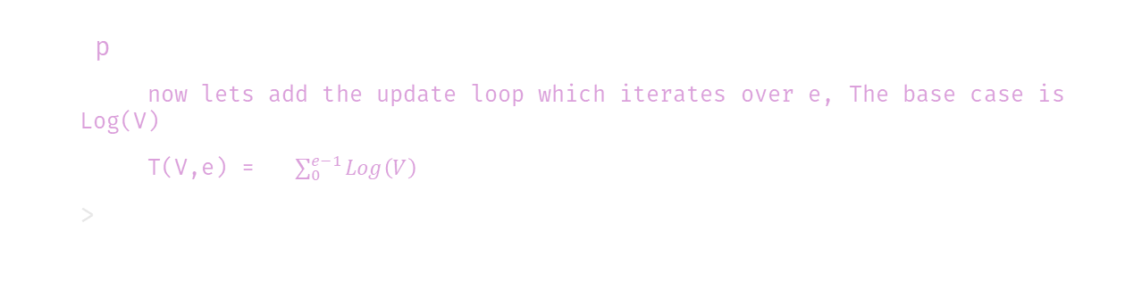
Time complexity; {
Dijkstra.py
Made_with_pycharm.mainpy
<p
now lets add the update loop which iterates over e, The base case is Log(V)
T(V,e) = $\sum_{0}^{e−1}{Log\left(V\right)}$
>
</p>
}

Slide 31
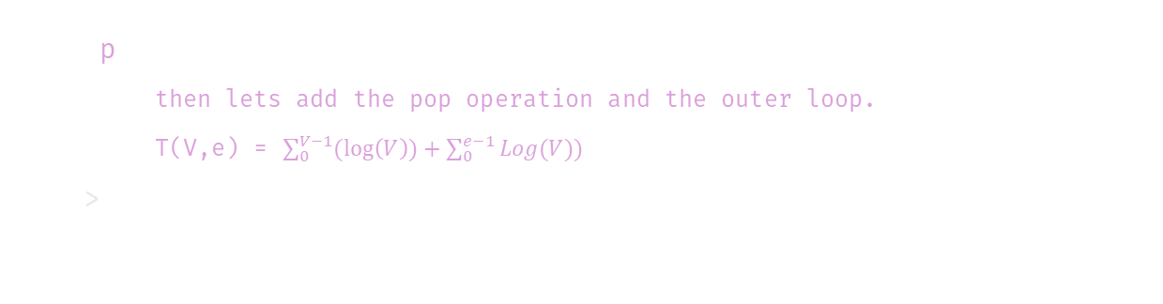
Time complexity; {
Dijkstra.py
Made_with_pycharm.mainpy
<p
then lets add the pop operation and the outer loop.
T(V,e) = $\sum_{0}^{V−1}{(\log\left(V\right))+\sum_{0}^{e−1}{Log(V))}}$
>
</p>
}

Slide 32
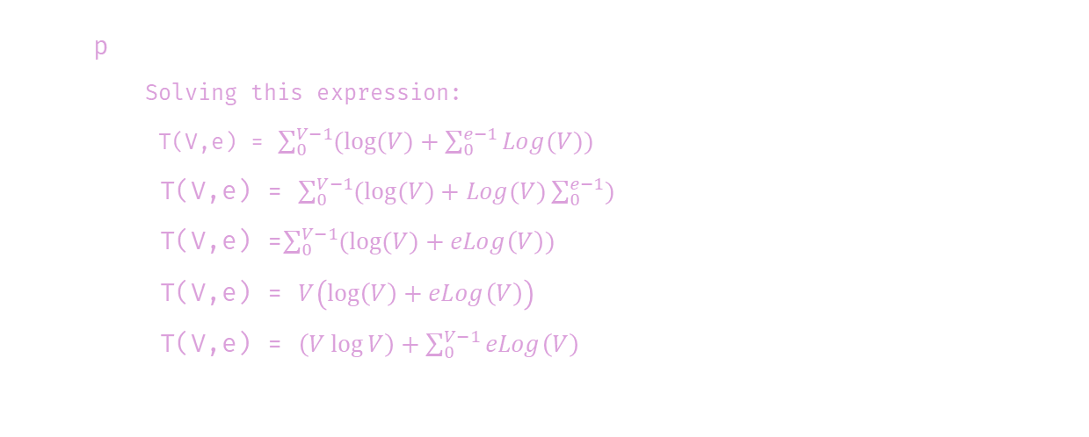
Time complexity; {
Dijkstra.py
Made_with_pycharm.mainpy
<p
Solving this expression:
T(V,e) = $\sum_{0}^{V−1}{(log⁡(V)+\sum_{0}^{e−1}{Log(V))}}$
T(V,e) = $\sum_{0}^{V−1}{(log⁡(V)+Log(V)\sum_{0}^{e−1}{)}}$
T(V,e) =$\sum_{0}^{V−1}{(log⁡(V)+eLog\left(V\right)) }$
T(V,e) = $V\left(\log\left(V\right)+eLog\left(V\right)\right)$
T(V,e) = $\left(V\log{V}\right)+\sum_{0}^{V−1}{eLog\left(V\right) }$
</p>
}

Slide 33
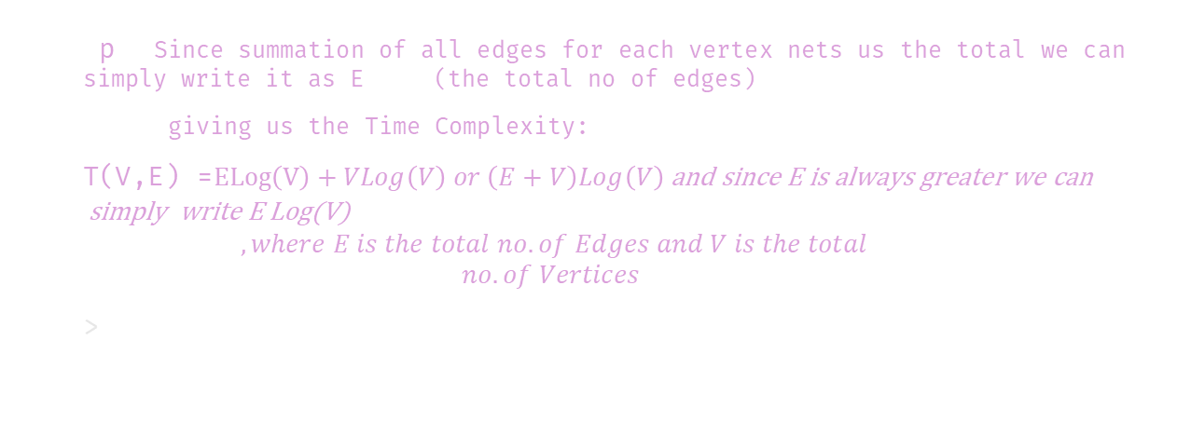
Time complexity; {
Dijkstra.py
Made_with_pycharm.mainpy
<p Since summation of all edges for each vertex nets us the total we can simply write it as E (the total no of edges)
giving us the Time Complexity:
T(V,E) =$ELog\left(V\right)+VLog\left(V\right) or \left(E+V\right)Log\left(V\right) \text{and} \text{since} \text{E} \text{is} \text{always} \text{greater} \text{we} \text{can} \text{simply} \text{write} \text{E} \text{Log}\text{(}\text{V}\text{)}$
$$, where E is the total no. of Edges and V is the total$$
$$no. of Vertices$$
>
}
</p>

Slide 34
Dijkstra.py
Made_with_pycharm.mainpy
[]
Thank Yolm;lk;lu

Slide 35
Dijkstra.py
Made_with_pycharm.mainpy
[Thank You]

